Slide 1
School-Level Poverty Measures: An Exploratory Pilot Project
A video recording of this webinar is available at https://youtu.be/bSJgpByOS6Q.

Slide 2
School-Level Poverty Measures: An Exploratory Pilot Project
October 14, 2021
Dan Ralyea
South Carolina Department of Education
Susan Williams
Virginia Department of Education
Alex Mattera
Virginia Department of Education
Jeff Sellers
SLDS State Support Team

Slide 3
Session Overview
Background Information
State Panel Perspective
Q & A
Wrap Up

Slide 4
Purpose of the Session
Equity-focused education policy and research depend on being able to measure poverty. However, free and reduced-price lunch (FRPL) eligibility data can be a difficult proxy for poverty because the data were not designed for that purpose.
This session will highlight an NCES project to make available neighborhood poverty estimates and, as a result, better poverty data.

Slide 5
School-Level Poverty Measure Testing Overview
FY19 SLDS grantees could apply for additional funding to help the U.S. Department of Education (ED) test a proposed school-level poverty measure. Sixteen grantees chose to participate.
Participating states create geocoded student-level address data to connect with data from NCES. They will use this newly combined information to summarize existing (e.g., FRPL) and proposed poverty measures and share these summaries with ED.
Participating states are always in control of their geocoded student address data, and no individual student data are shared outside the state.

Slide 6
Subgroups
Participating grantees were divided into three subgroups based on their current capabilities to allow for more effective technical assistance.
Subgroup 1: Initial stages of data definition and collection
Subgroup 2: Data collection and initial stages of geocoding are underway
Subgroup 3: Data are available, and analysis is taking place

Slide 7
BlindSIDE Poverty Assignment Tool
Assigns poverty indicator (income-to-poverty ratio) to geocoded address locations
Uses the same federal poverty criteria, data, and metric as FRPL thresholds (130%, 185%)
Sends geolocated poverty data back to your local browser for processing
Does not share student data with NCES; tool access is password protected
Input (CSV file):
Geocoded address file with student ID, school ID, latitude, and longitude (5-digit minimum)
Outputs (CSV files):
Student assignment: SIDE poverty estimate (0-1000) and standard error
School summary: mean, median, standard deviation, coefficient of variation, percent under 100, and percent under 130
Notes:
Charles

Slide 8
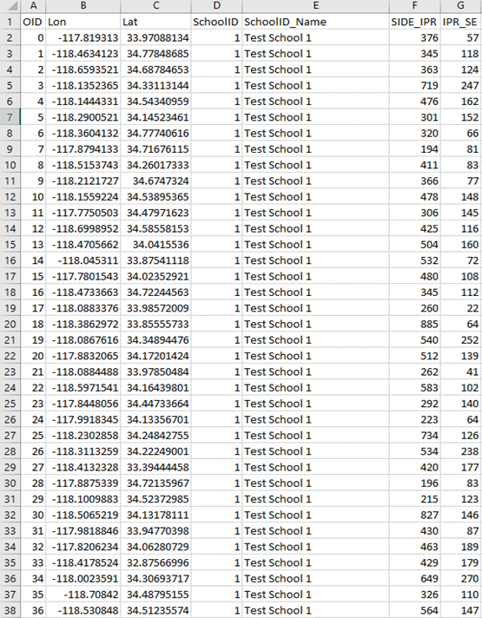
Initial Input: Student File

Slide 9
Resulting Output
Original student items
New poverty estimates
School poverty estimate summary

Slide 10
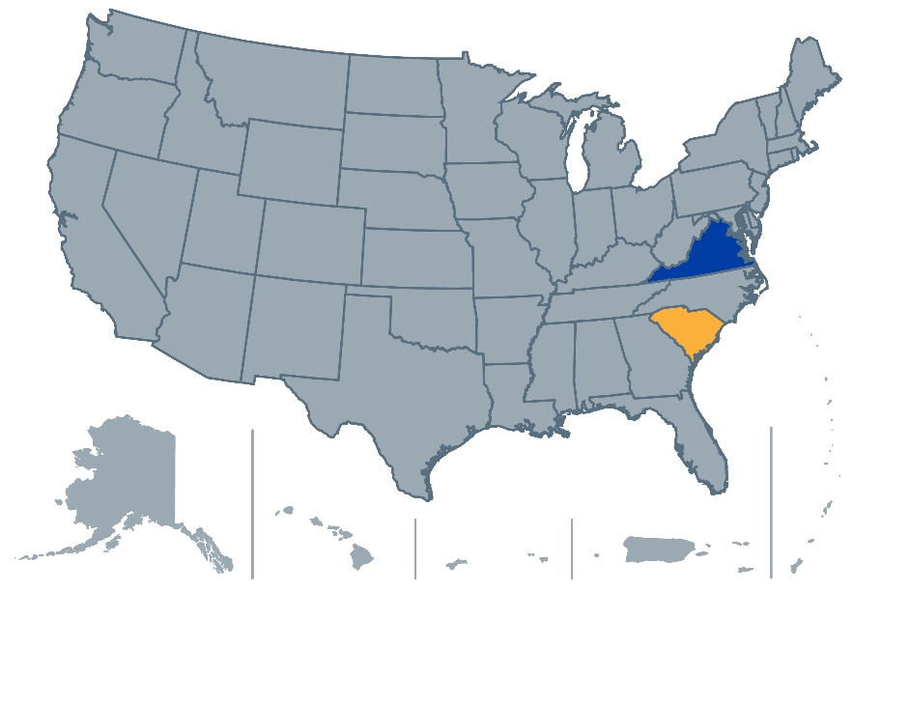
State Panel Perspective
Dan Ralyea, South Carolina Department of Education
Susan Williams and Alex Mattera, Virginia Department of Education

Slide 11
South Carolina Context
Presented by
Dan Ralyea, Director
Office of Research and Data Analysis (ORDA)

Slide 12
Homogenous Student Information System
Statewide PowerSchool Implementation
PowerSchool has a long history of collecting student addresses.
Non-validated and non-standardized
Multiple addresses (residence, mailing, alternate contact)
State-provided busing solution
South Carolina owns all the buses
South Carolina pays for gas

Slide 13
Homogenous Validation System
State-sponsored validation services at point of entry
Level Data has state-supported contract for connector services, real-time reporting, and data validation at point of entry.
Addresses are validated with the Coding Accuracy Support System (CASS), a certification system from the United States Postal Service. A CASS-certified address validation service will standardize your mailing list, update outdated addresses, and verify that addresses are valid and complete.

Slide 14
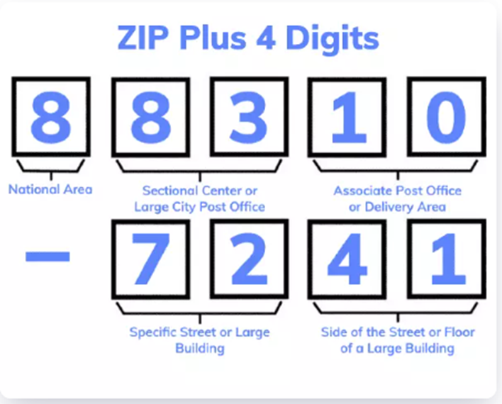
Geocoding
South Carolina’s Geocoding Adventure
It is a major effort for districts to standardize addresses. External services can do bulk standardization, but addresses need to be verified at the local level.
Geocoding services can function differently. Our first attempt focused on zip codes, with interesting results. Geocoding based on 5-digit codes assigns all addresses at the geographic center of the zip code—in some cases showing houses in the middle of a body of water.
Zip + 4 reports locations on a grid for postal delivery generally within 4 or 5 houses.
Zip +4 changes as postal routes change.

Slide 15
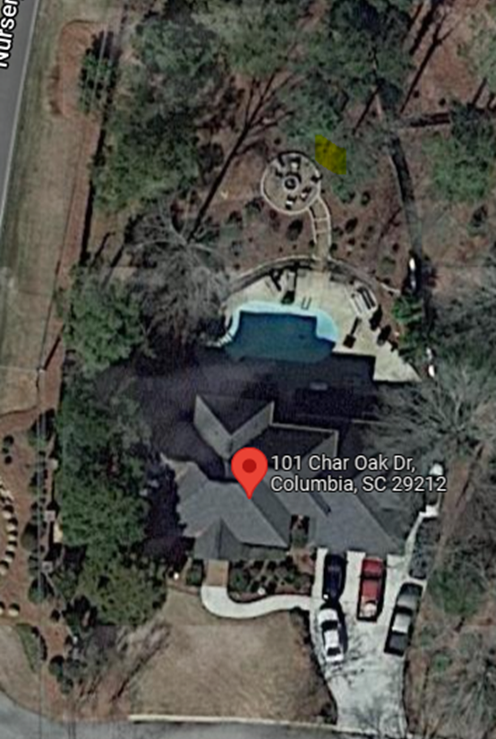
Rooftop Geocoding and e-911
Rooftop geocoding uses the geocode of the rooftop of a physical building rather than the center of the piece of property. This approach is important in rural areas.
State governments have developed or are developing e-911 systems. Partnerships with other state agencies may reduce the cost of GIS validation services.

Slide 16
Communicating With Local Districts
Most South Carolina districts require proof of residency at annual re-enrollment, but the address quality at the point of entry had many issues. SCDE offered bulk address scrubs and address validation at time of entry, and data quality is still poor.
We are gaining traction through consistent messaging with district leaders about the use case for poverty identification.
South Carolina applies an add-on weighting to funding for students in poverty.

Slide 17
Contact Information
Dan Ralyea, Director
Office of Research and Data Analysis
South Carolina Department of Education
dralyea@ed.sc.gov

Slide 18
Virginia and the Poverty Study
Where We Are & What’s Next

Slide 19
Collecting Student-Level Data in Virginia
A legacy system of high-quality data
No statewide student information system
No APIs or nightly uploads
An LDS without being “the SLDS” (or VLDS)
Quality, well-defined data standards and edits
Rigorous verification process before data are stored and used
“Cross-vetting” as much data as possible
Tangent applications
Data elements used in multiple applications and calculations

Slide 20
Major Student-Level Data Collections
Student Record Collection (SRC)
Every student who depends on a public school division in Virginia for a free appropriate public education must be included in each student record collection. This includes all full-time and part-time students served in the division's schools as well as those the division has helped place in other public and private schools/centers regardless of how the placements are funded. Students in local or regional jails are reported by the division that serves the jail.
SRC feeds cohort calculations, including on-time graduation rate.
Master Schedule Collection (MSC)
Student Behavior and Administrative Response Collection (SBAR)

Slide 21
Student Record Collection
Collection dates
Fall SRC: October 1
Spring SRC: March 31
End of Year SRC: Last day of school
Summer SRC: Summer graduates only
Fall SRC
Fall membership (official enrollment for the school year)
Virginia preschool funding and K-3 class-size reduction funding
Title funding including English learners
Student addresses for the economically disadvantaged identification study

Slide 22
Student Address Data Elements
Governance
VDOE is participating in a poverty study as part of a federal grant. The address lines have been activated for fall SRC while the study is ongoing.
Definitions
Address Line1 and Address Line2
Current street address of the student including house number and street name
Zip Code
Current zip code of the student’s street address
Edits
Required for all active and virtual-only students
PO boxes are not permitted

Slide 23
Verification of the SRC Data
Once data are complete, each district verifies its data
9 mid-level approvers per district (finance, special education, prekindergarten, Title I, etc.)
1 superintendent or designee
The Office of Data Services publishes fall membership
That publication serves as a notice that fall SRC data can be used.
For this project, the Office of Research will be notified that the data are ready to use.
The Office of Research has read access to the database
Research analysts will pull the data needed for the study.

Slide 24
Geocoding Addresses
Virginia has a statewide GIS Clearinghouse as part of the Virginia Geographic Information Network (VGIN). This system contains the most accurate GIS data for Virginia and is updated quarterly.
VDOE will use the GIS data from VGIN to geocode addresses.

Slide 25
Geocoding Addresses
Issues to address before VDOE can complete the geocoding process
Accuracy of address data, including city names and zip codes
Computing power to geocode the volume of records
VDOE currently uses a free, open-source GIS tool called QGIS. We do not know its capacity to bulk geocode the volume of records needed for this project.

Slide 26
VDOE’s Interest in Participating in the Study
Several types of state education funds in Virginia are distributed based on the percentage of students eligible for free meals. These funds provide additional programs and services to students in need.
It has become harder to accurately measure student poverty with the Community Eligibility Provision and, more recently, flexible school meal program eligibility during the COVID-19 pandemic.
The Virginia General Assembly is interested in an alternative student poverty metric, but so far proposed metrics have not been able to distribute funds equitably.

Slide 27
Research Questions for Virginia
How do SIDE-modeled poverty data correlate with available state data on eligibility for free- and reduced-price meals and economically disadvantaged status?
How do SIDE-modeled poverty data change our understanding of concentrated or disperse student and family poverty in Virginia?
How would SIDE-modeled poverty data change the distribution of state funds and identification of priority schools or communities for educational intervention?

Slide 28
Next Steps for Virginia
Based on the results of this study, VDOE will assess the feasibility of substituting or augmenting free-meal eligibility data with SIDE-modeled poverty estimates.
We will assess feasibility based on:
Confidence in the results
VDOE’s continuing capacity to produce estimates
Changes in funding distributions based on models
Political interest in proposed alternatives

Slide 29
Resources
Alex Mattera, Senior Research Analyst in the Office of Research, alex.mattera@doe.virginia.gov
Susan Williams, Director of the Office of Data Services, susan.m.williams@doe.virginia.gov
VDOE data collections (our LDS but not “The SLDS”), https://www.doe.virginia.gov/info_management/data_collection/index.shtml
Virginia Longitudinal Data System (“The SLDS”), http://vlds.virginia.gov/

Slide 30
Questions?
Type your questions for the panelists into the Chat feature on your screen.

Slide 31
Contacts
Contact Information
Dan Ralyea, South Carolina Department of Education, dralyea@ed.sc.gov
Susan Williams, Virginia Department of Education, susan.m.williams@doe.virginia.gov
Alex Mattera, Virginia Department of Education, alex.mattera@doe.virginia.gov
Jeff Sellers, SLDS State Support Team, jeff.sellers@sst-slds.org
For more info about the SST and to request support
SLDS Communities360 website, http://slds.ed.gov
Contact your state’s SST Point of Contact for assistance: https://slds.ed.gov/#communities/pdc/documents/14522

Slide 32
Thank you!

